Slide 1
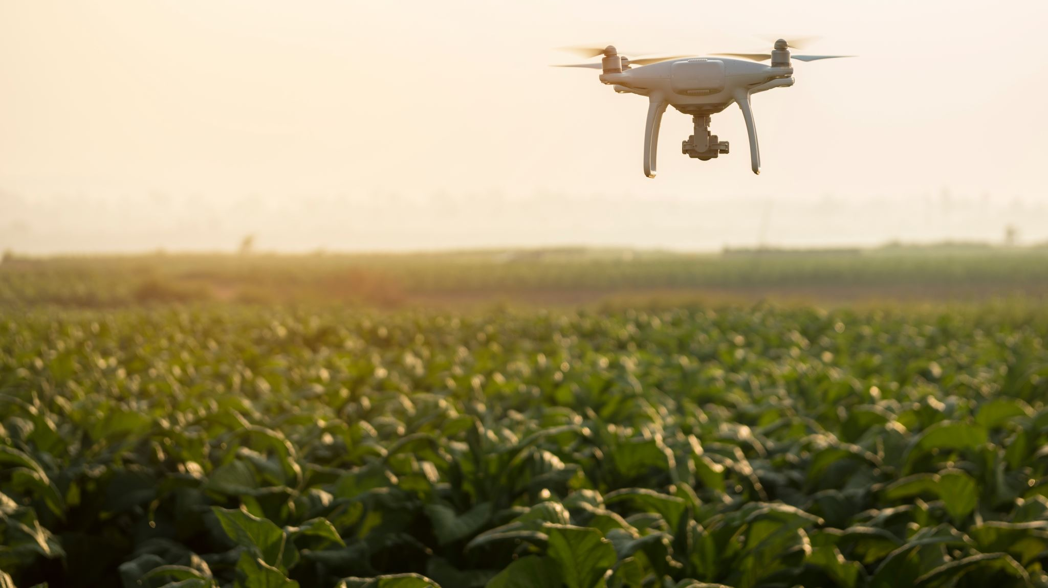
Detection Of Drone
Tanoj Kumar Anapana
Kavyasree Moktala
Sai Deepak Devadari

Slide 2
Project Overview
Goal: Detect drones in real-time using embedded hardware and computer vision.
Components:
- Raspberry Pi + Camera Module
- Ultrasonic Sensor
- YOLOv8 Deep Learning Model

Slide 3
Problem Statement
With the rapid increase in drone usage across various sectors—delivery, surveillance, and recreation—there is a growing concern about unauthorized or potentially dangerous drones entering restricted or sensitive areas such as airports, military bases, government facilities, and private properties.
Conventional drone detection systems are often expensive, complex, and require high-power infrastructure, making them impractical for small-scale or remote applications. There is a pressing need for a low-cost, portable, and intelligent solution that can automatically detect drones in real time using minimal hardware.

Slide 4
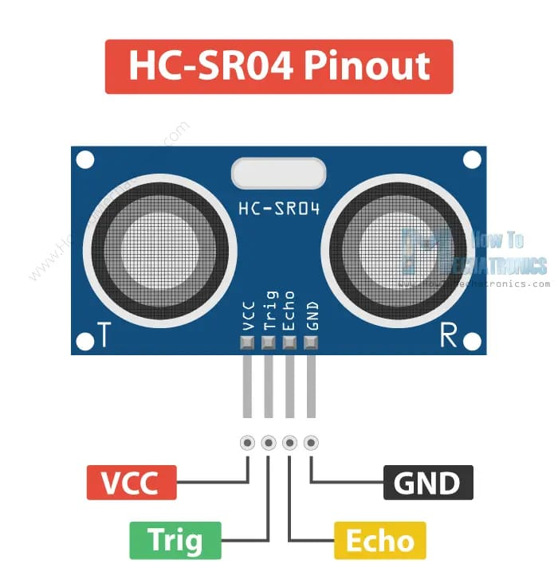
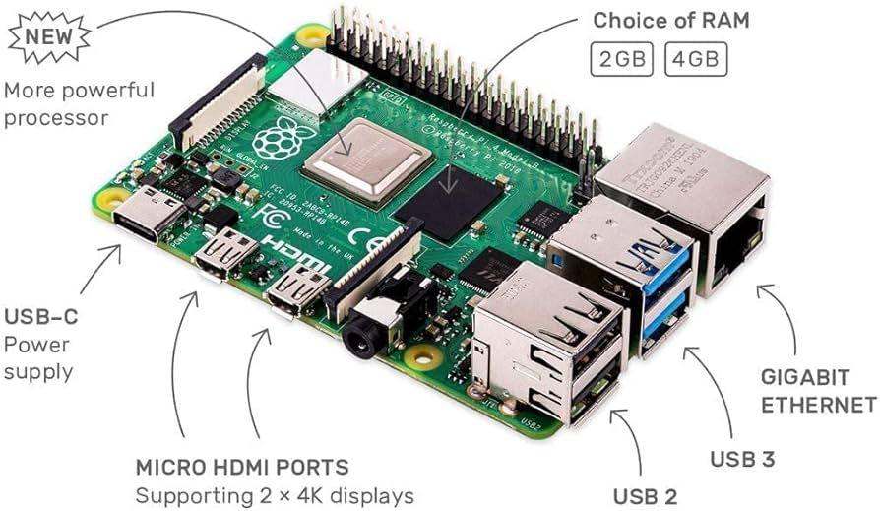
Ultrasonic Sensor:
An ultrasonic sensor measures distance by emitting ultrasonic sound waves (frequencies higher than 20 kHz) and detecting the reflected waves. By measuring the time it takes for the sound to travel to an object and back, the sensor can calculate the distance.
Raspberry Pi 4:
Raspberry Pi is a small single-board computer (SBC). It is a credit card-sized computer that can be plugged into a monitor. It acts as a minicomputer by connecting the keyboard, mouse, and display.

Slide 5
Level-0
Identifying drone
Drone Image
Drone Detection

Slide 6
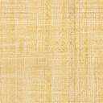
Level-1
Arduino
Ultrasonic sensor
Detecting object
Detected object
Image
Captured
object
yolov8
Object
Raspberry cam
Raspberry Pi
Signal
Identifying drone or not

Slide 7
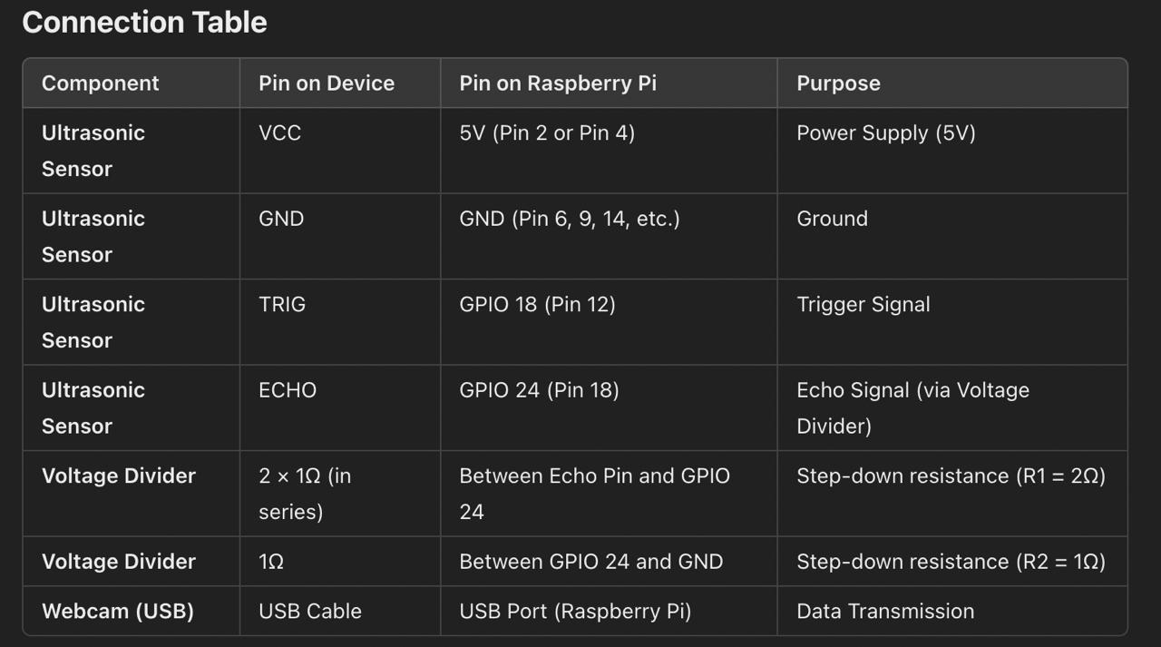
Connections

Slide 8
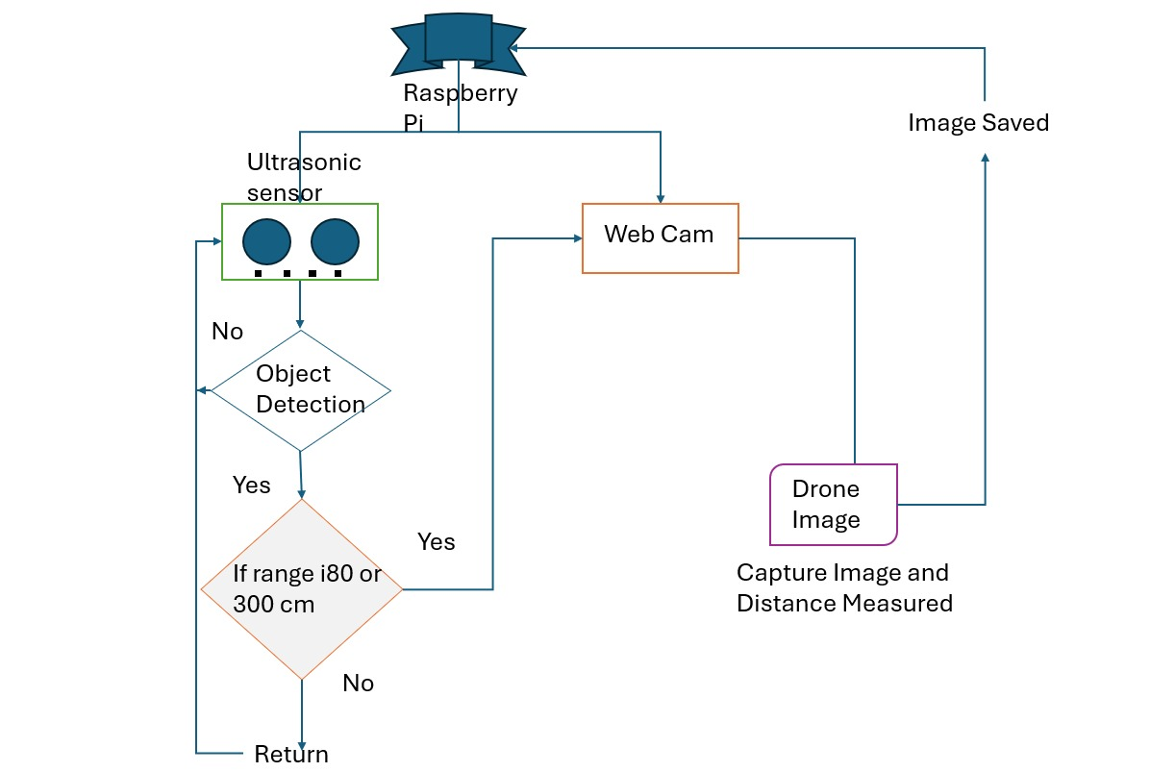
Flow Chart of Drone Detection

Slide 9
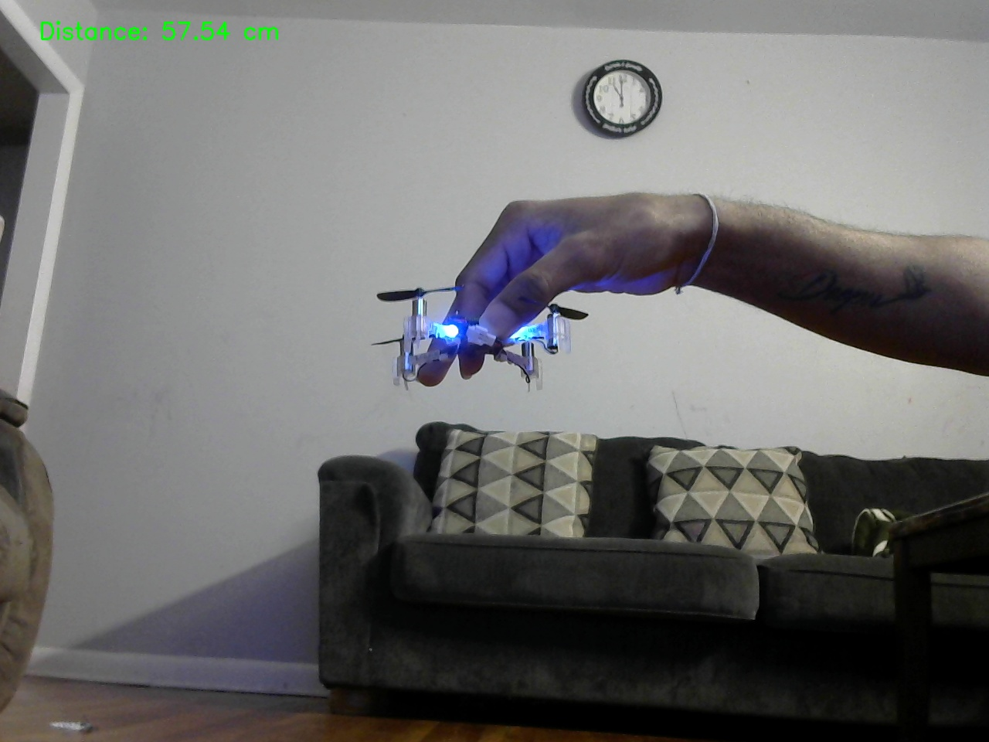
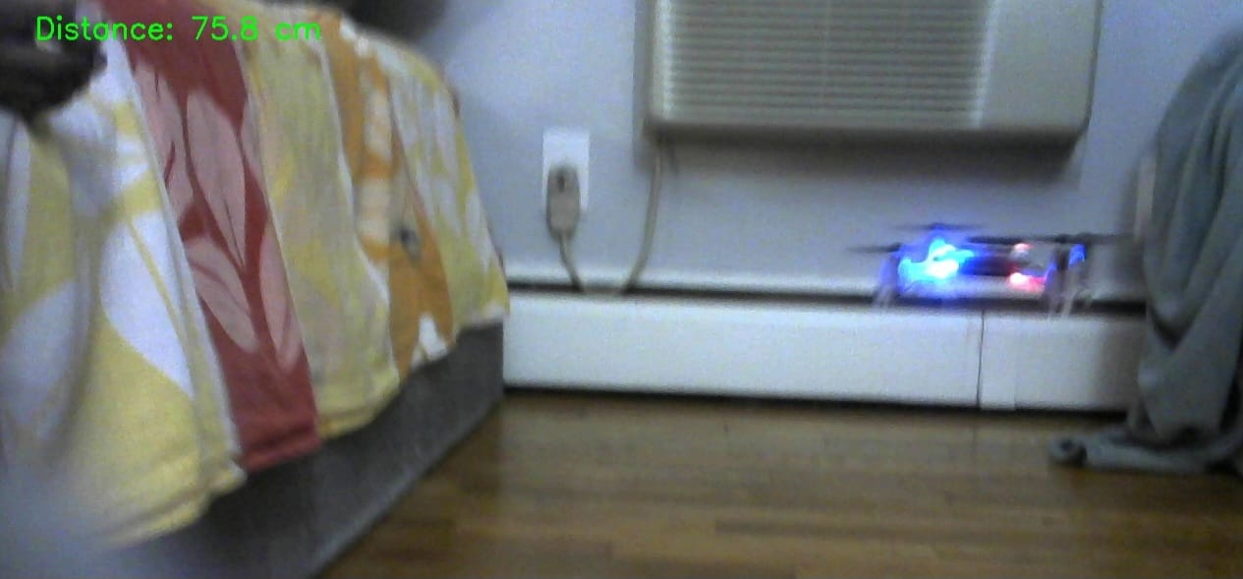
Results for Object Detection
Demo Video for Object Detection
https://youtu.be/C7htch4zTk8?si=2kfPmkAobmLUvOl6

Slide 10
Level-2
Dataset
Train Img
Test Img
Training Yolov8
Detecting object
Arduino
Ultrasonic sensor
Detected object
Val Img
Image
Raspberry Pi
Captured
Image
Yolov8
Captured Object
Raspberry cam
Signal
Identification of Drone

Slide 11
Yolov8 Model
Input Image
Backbone
Neck
Resized and Preprocessed
Feature extractor
Feature
Fusion
Post-Processing
Head
Out-put
Bounding box
Remove duplicate boxes
Labels, confidence score
Notes:
Highlights certain pattern helps the network model breaks up the input space into non-linear region

Slide 12
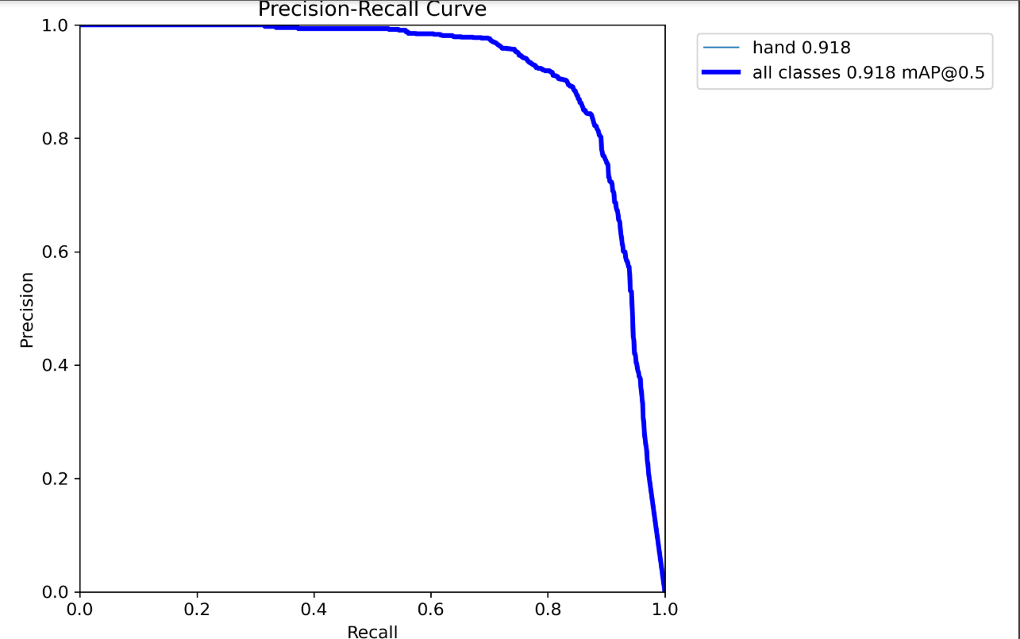
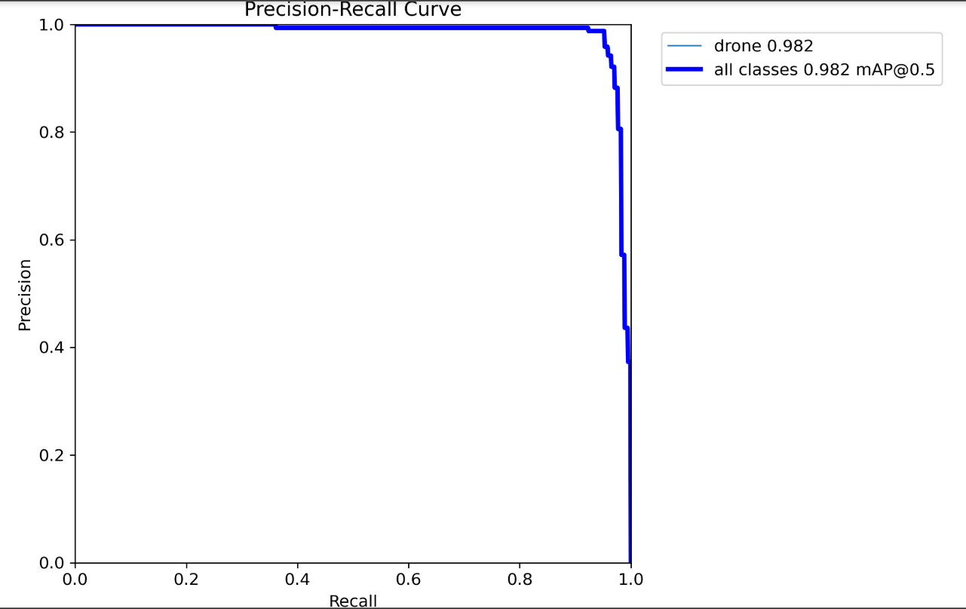
Precision vs Recall Curve
Hand
Drone
Notes:
The model correctly predicts the positive class the model incorrectly predicts the negative class

Slide 13
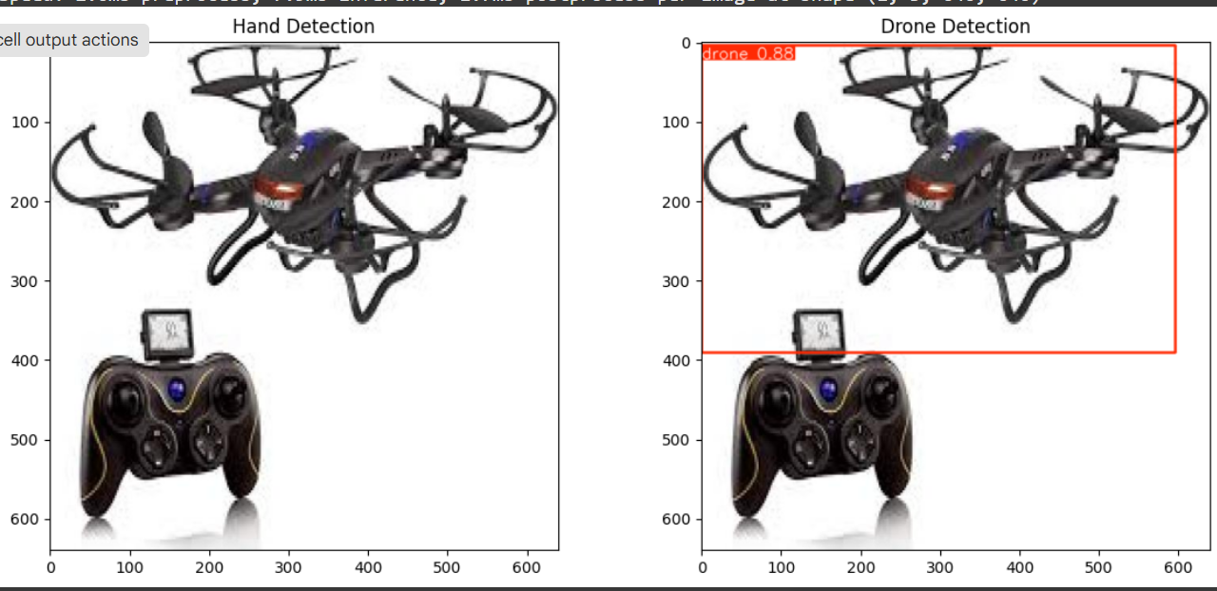
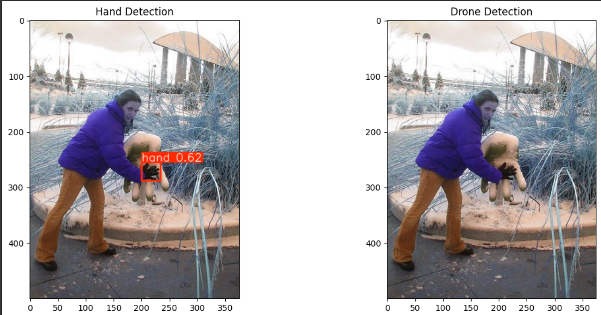
Results
Drone Detection
Hand Detection

Slide 14
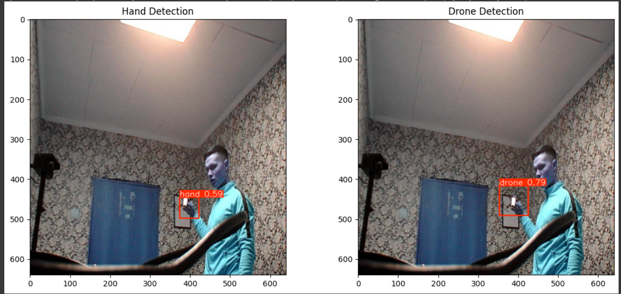
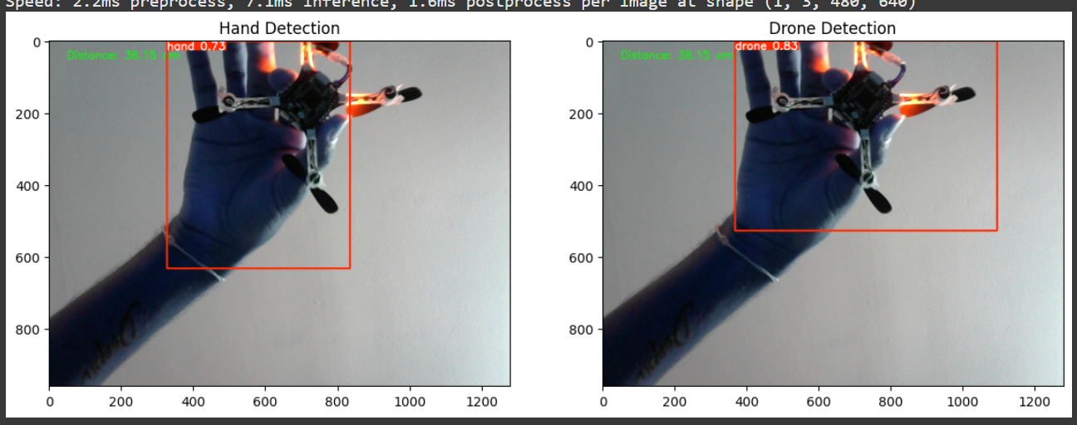
Results
Test Image
Raspberry Pi cam

Slide 15
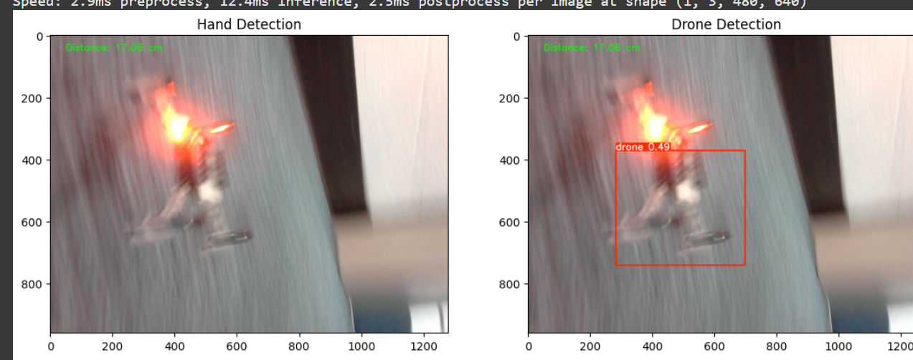
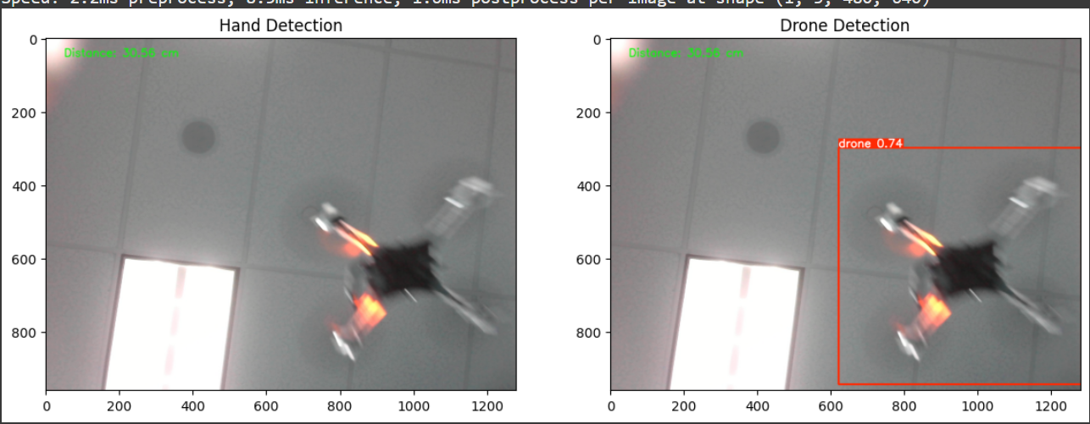
Results

Slide 16
Conclusion
The project successfully demonstrates a cost-effective and intelligent drone detection system using Raspberry Pi, ultrasonic sensor, and YOLOv8.
By using the ultrasonic sensor to trigger the camera, the system reduces unnecessary image capture and processing, making it energy-efficient and optimized for embedded systems.
The YOLOv8 model accurately detects drones from captured images, validating the feasibility of integrating AI-based detection on edge devices.
This solution can be deployed in sensitive areas to alert authorities of potential drone intrusions without relying on expensive or bulky detection systems.

Slide 17
Limitation
Using a Raspberry Pi for AI model is slow compared to using a powerful GPU. Raspberry Pi’s slowness makes it difficult to process things in real-time.
* It is challenging to capture a clear image at a distance from the camera module due to image noise
concerns.
* Due to the various lighting conditions, the color differences made it difficult for YOLOv8 to detect the image.
* Detecting a hand in images captured from a long distance is difficult, where the drone is detectable.
* We faced challenges like various image conditions, lower detection accuracy also during applying the techniques, data processing and fine-tuning.

Slide 18
Future Work
Real-time Video Detection: Extend the system to process video streams for continuous drone tracking.
Edge Optimization: Optimize the YOLOv8 model further for faster inference directly on Raspberry Pi.Alert
Mechanism: Add real-time notifications (e.g., buzzer, SMS, or cloud alert) when a drone is detected.
Multiple Object Detection: Enhance the model to detect other aerial threats or flying objects.
Cloud Integration: Store captured images and detection logs on the cloud for remote monitoring and analysis.
Power Efficiency: Incorporate solar power or battery management systems for use in remote locations.

Slide 19
Reference
https://www.bitcraze.io/documentation/tutorials/getting-started-with-crazyflie-2-x/
https://www.raspberrypi.com/
https://youtu.be/_7drIUmC8Zo?si=TV4T1c89DE0Xq2ua
Ritika Giridhar. (2022). Hand gestures dataset [Data set]. Kaggle. https://doi.org/10.34740/KAGGLE/DS/2206851
ITU. (2023, February). Drone Detection Dataset. Roboflow Universe. Available at: https://universe.roboflow.com/itu-t15gy/drone-detection-gayvs. Accessed on May 8, 2025.
project-986i8. (2023, August). Drone Dataset. Roboflow Universe. Available at: https://universe.roboflow.com/project-986i8/drone-uskpc. Accessed on May 8, 2025.

Slide 20
Thank You

